Slide 1
How to become a popular youtuber?
JIALE QIN
Data Science Track
Team 3

Slide 2
Overview
Customers: New Youtubers, non-popular Youtubers
Goals:
Present patterns of trending videos
Predict the result of new videos

Slide 3
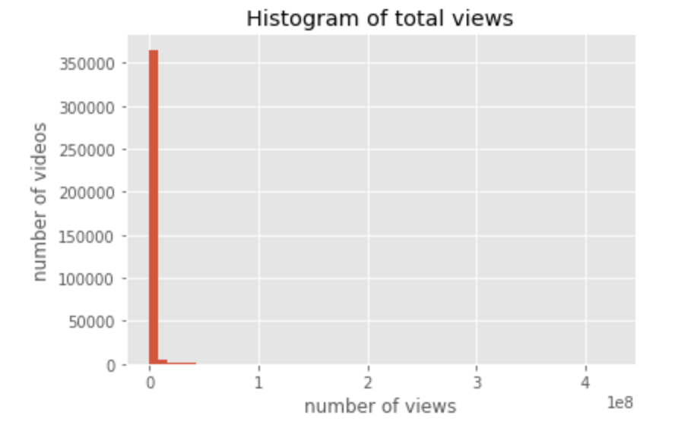
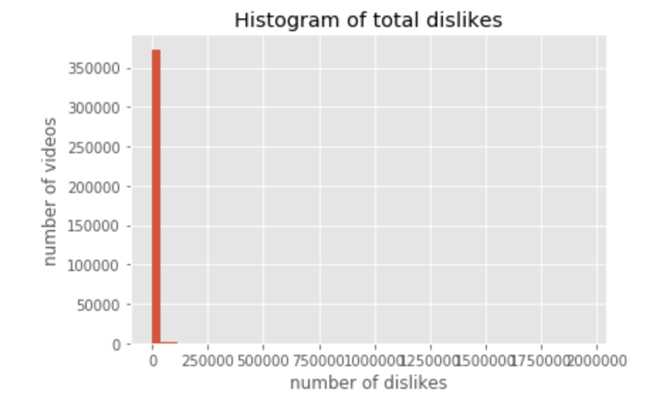
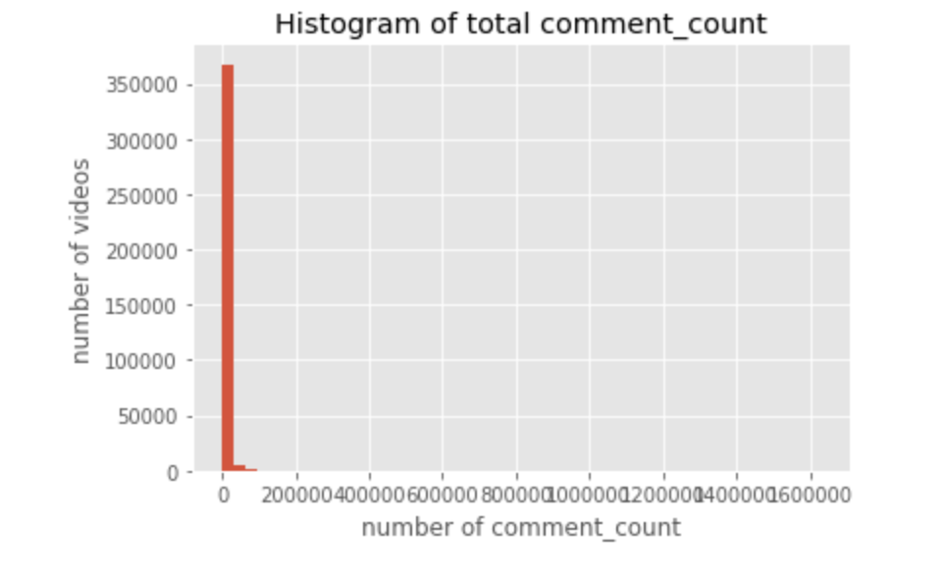
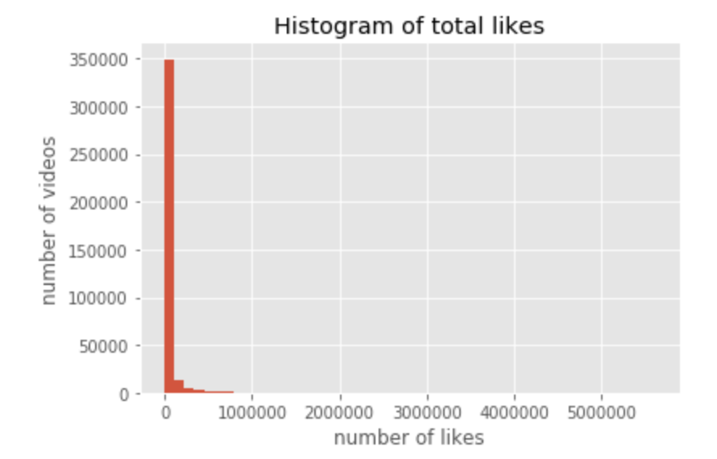
Patterns of trending videos
Numerical variables
10 countries
375,942 records in total

Slide 4
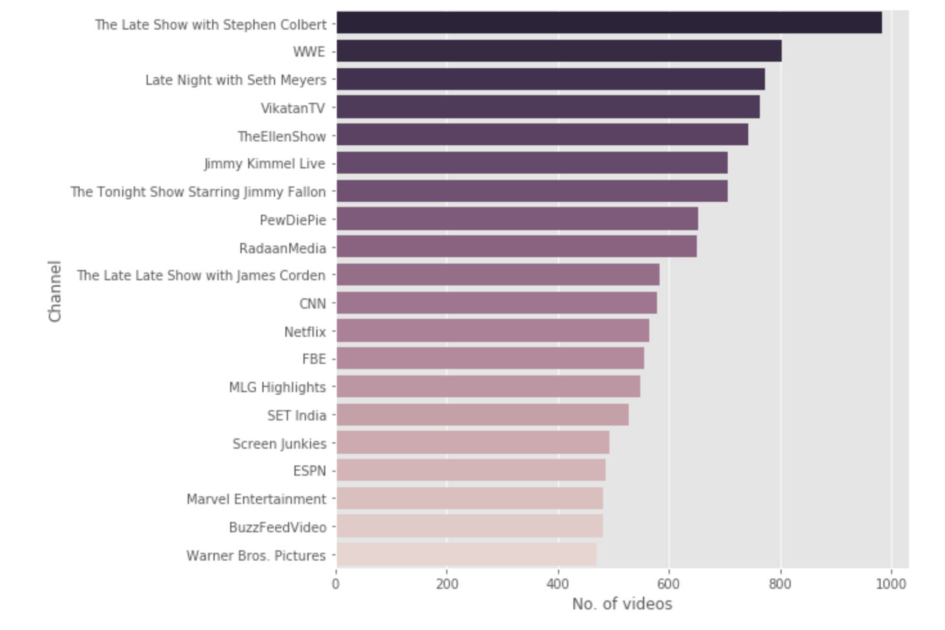
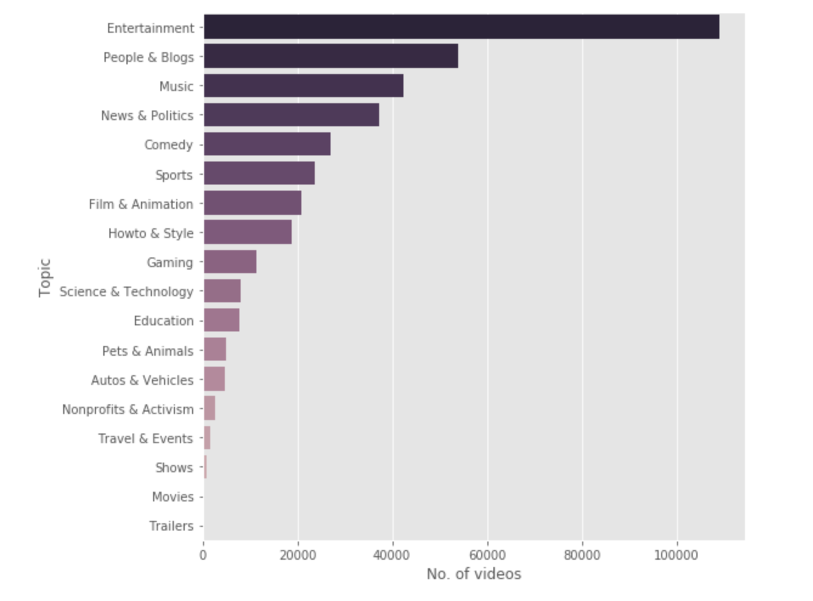
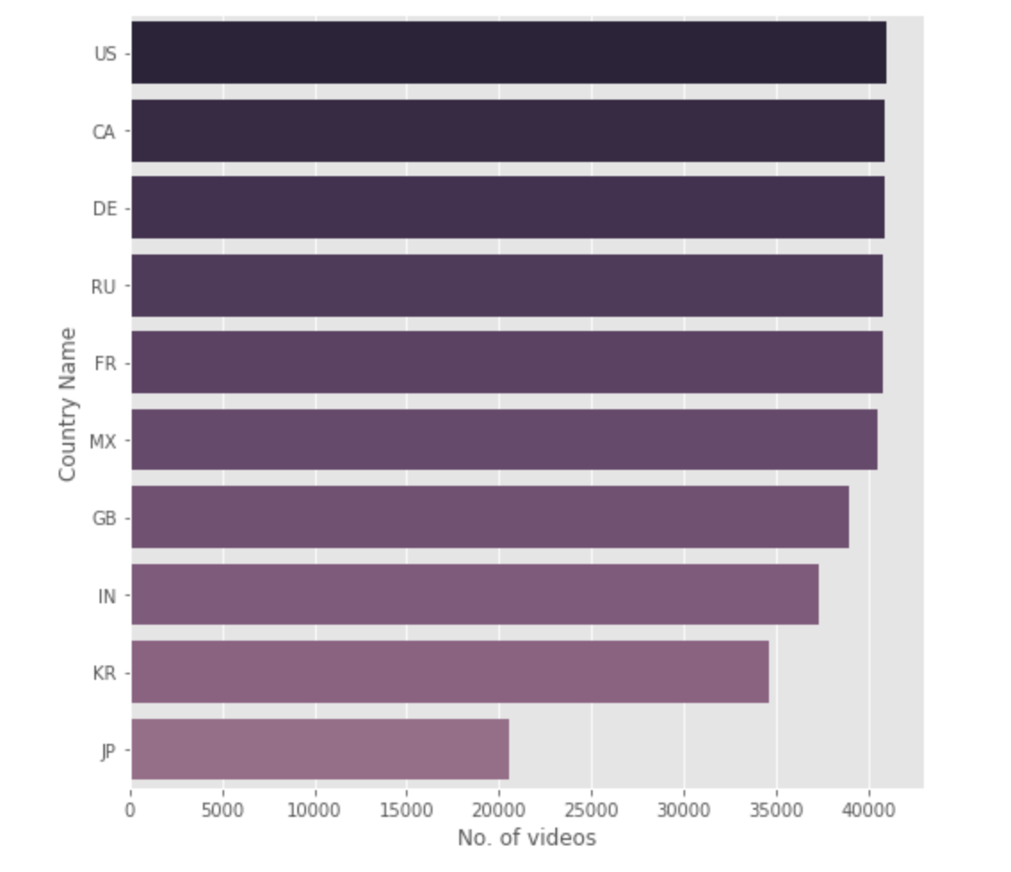
Patterns of Trending videos
Categorical Variables
Channel : ESPN
Country: US, CA, DE, RU, FR
Topic: Entertainment, People & Blogs, Music

Slide 5
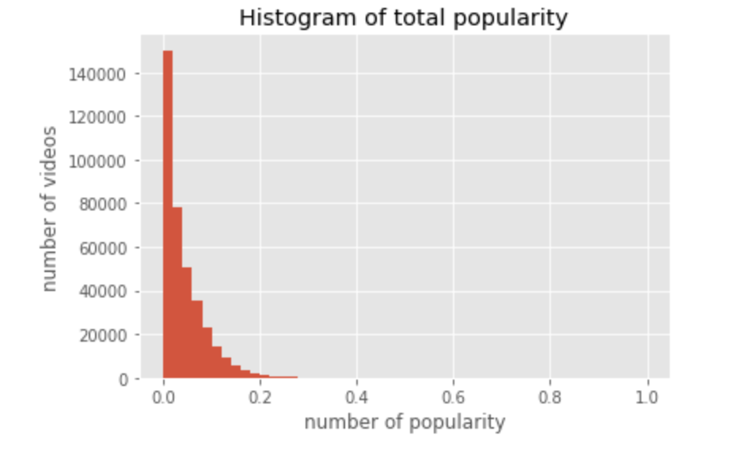
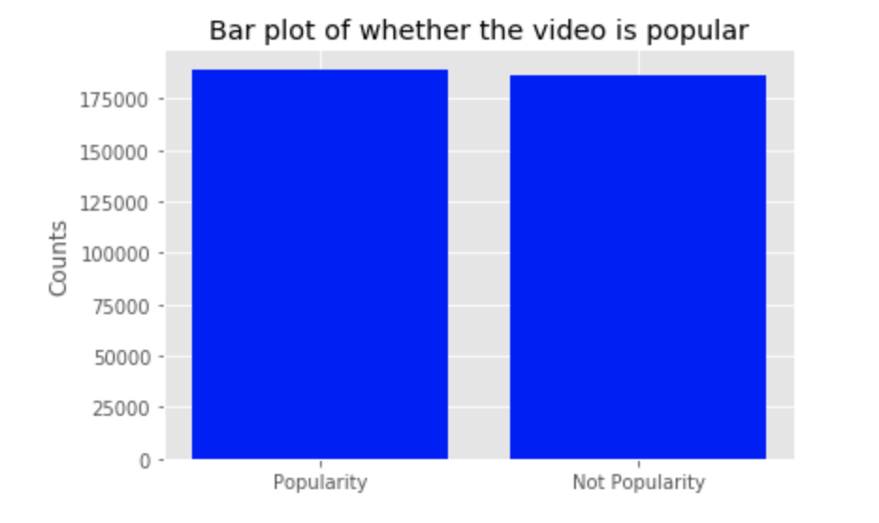
Predict weather a new video become popular
Define Target Variable:
Popularity
= (#likes + #dislikes + #comment_counts) / #views

Slide 6
Model Selection
Model | Accuracy
Linear Regression | 0.5718
Decision Tree | 0.7656
Random Forest | 0.7753
AdaBoost | 0.6632
XGBoost | 0.6781
KNN | 0.7393
Extra Tree | 0.7750

Slide 7
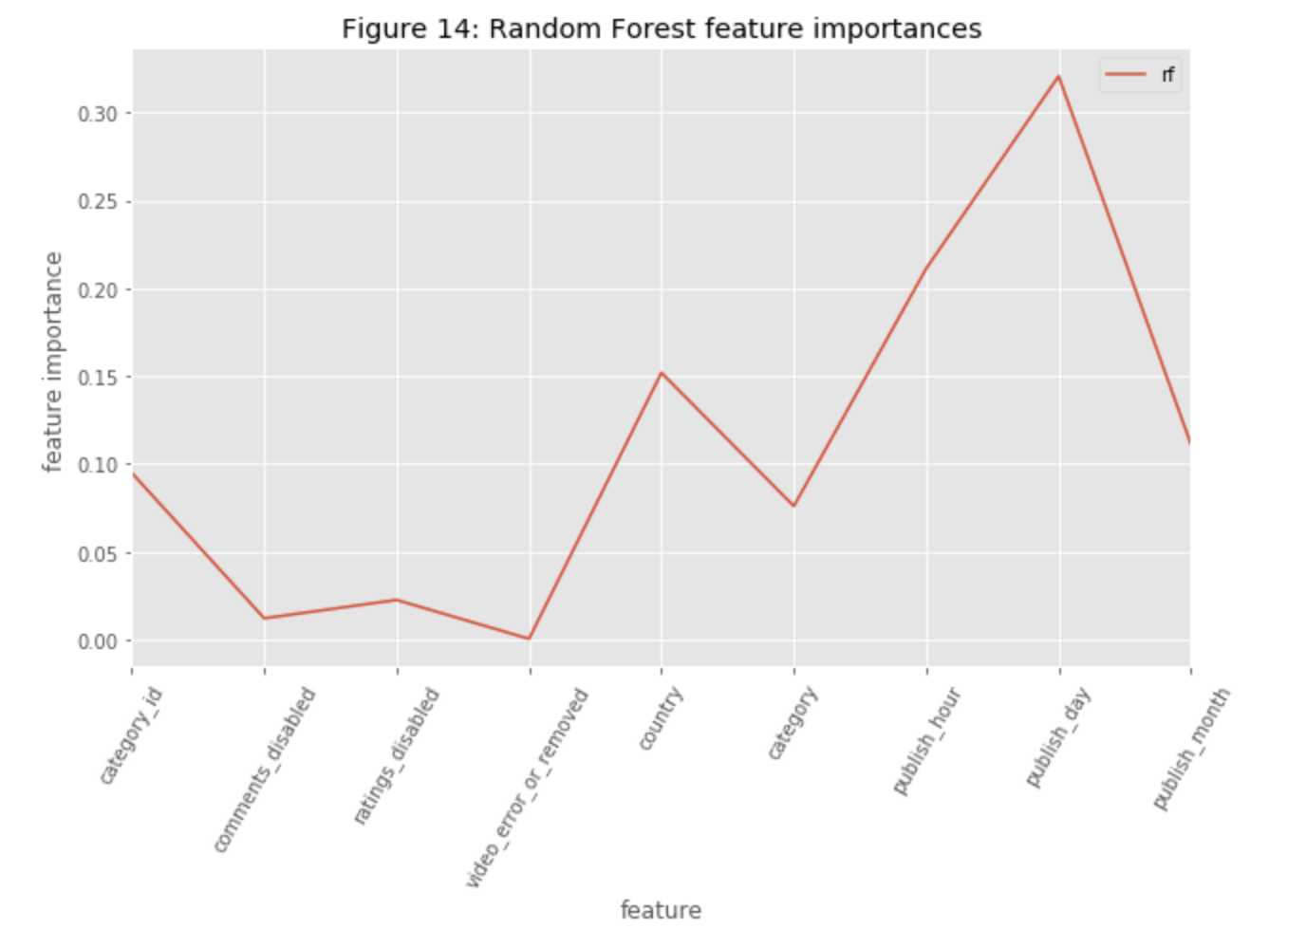
Feature Importance
Model accuracy: 0.7907
Publish day
Country
Category id

Slide 8
Future Work
Analysis: Global vs local, World Cloud for text data
Modeling: Hyperparameter tune, add text data, staking modeling

